Slide 1
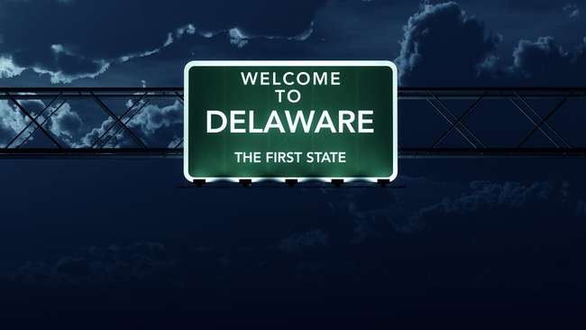
Notes:
First State to sign the U.S. constitution in 1787.

Slide 2
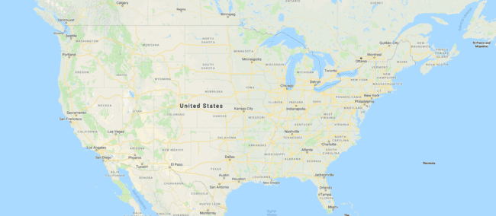
Notes:
Where is Delaware? We usually say: Dela - where

Slide 3
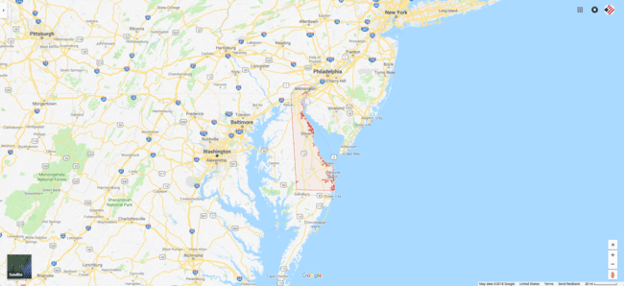

Slide 4
LE DELAWARE
et ses 15 secrets

Slide 5
RÉPUTATION INTERNATIONALE
1
Notes:
Delegations from around the world come to Delaware to learn and understand the functioning of its corporate system, which is absolutely unique in the world.

Slide 6
REGISTRES
PUBLICS
2
Notes:
Delaware’s public records contain the name of the company, its legal form, the date of its creation, and the name and address of its registered agent.
However, these records do not contain the name or address of the company’s shareholders, directors, or officers, unless this information was mentioned in the certificate of creation, which is rare.
The absence of this information is particular to Delaware. In most states, the public records generally contain the name and address of the company’s directors and officers.

Slide 7
INVESTISSEMENT
REQUIS
3
Notes:
Delaware does not require a minimum investment in the company. The shares need not have a par value, and a paid-up share capital of $1 is sufficient.

Slide 8
COMPTE
BANCAIRE
4
Notes:
A company created in Delaware has no obligation to have a bank account in this state.
In fact, there is no obligation for a Delaware company to have a bank account in the United States.
But it is normal and especially logical for a U.S. company to have a bank account on U.S. soil.

Slide 9
SIÈGE SOCIAL
5
Notes:
A company created in Delaware has no obligation to have its head office or principal place of business in the state.
But what we often see is a head office in Delaware and a principal place of business in another state.

Slide 10
ACTIONNAIRES ADMINISTATEURS DIRIGEANTS
6
Notes:
A single individual can be a shareholder, director, and officer of a Delaware company, all at the same time.
The minimum is, therefore, one person. In addition, there is no obligation to reside in Delaware or even hold meetings there.

Slide 11
LIBERTÉ DES
ADMINISTRATEURS
7
Notes:
The directors of a company created in Delaware are free to establish the selling price of the company’s shares.
They can also adopt, amend, or repeal any of the company’s by-laws. In other words, they have a lot of freedom.

Slide 12
IMPÔT
CORPORATIF
8
Notes:
MOST IMPORTANT SECRET : If a Delaware company does not have a physical place of business in the state, it generally does not have to pay income tax in Delaware.

Slide 13
IMPÔT PERSONNEL ET TAXE DE VENTE
9
Notes:
Generally, if a person holds shares of a Delaware company, but does not reside there, the person does not have to pay income tax in Delaware.
In addition, Delaware does not have a sales tax. CHINOIS FROM NYC. DE = SOMETIMES BLACKLISTED BY APPLE FOR 1-2 WEEKS AFTER LAUNCHING A NEW PRODUCT

Slide 14
DROITS DE SUCCESSION
10
Notes:
Generally, if a person holds shares of a Delaware company, but does not reside there, no succession duties are payable in Delaware when the person dies.

Slide 15
LÉGISLATION FAVORABLE
11
Notes:
Delaware has enacted a series of corporate laws that are favorable to companies and recognize the freedom to contract.
These laws are among the most advanced and flexible in the United States.
The Delaware legislature constantly updates these laws in order to maintain their effectiveness. MBNA EXAMPLE

Slide 16
TRIBUNAL
SPÉCIALISÉ
12
Notes:
In Delaware, there is a specialized court in corporate law called the Court of Chancery. The Court relies on case law developed over more than 200 years, which insures a great deal of consistency in the decisions it makes.
VERY DIFFICULT TO BECOME A JUDGE IN THIS COURT.

Slide 17
COÛT DE CRÉATION ET TAXE ANNUELLE
13
Notes:
The cost of creating a Delaware company is among the lowest in the United States.
As for the annual corporate tax, it is comparable to the corporate tax paid elsewhere in the country.

Slide 18
RAPIDITÉ DE CRÉATION
14
Notes:
In Delaware, it is possible to create a company in just half an hour. FLORIDA = NO EXPRESS SERVICE

Slide 19
FACILITÉ DE CRÉATION
15
Notes:
It is very easy to create a company in Delaware, especially when you use the services of an attorney or a firm specialized in the creation of U.S. companies.
CorpoMax is a Registered Agent with Online Access (Online Agent)
Good Standing:

Slide 20
LE DELAWARE
statistiques et exemples

Slide 21
+ 50% SOCIÉTÉS PUBLIQUES
+ 67% SOCIÉTÉS Fortune 500
+ 50% SOCIÉTÉS NY Stock Exch.
+ 89% IPO
+ 1.5M entités ACTIVES
+ 226,000 nOUVELLES entitÉS

Slide 22
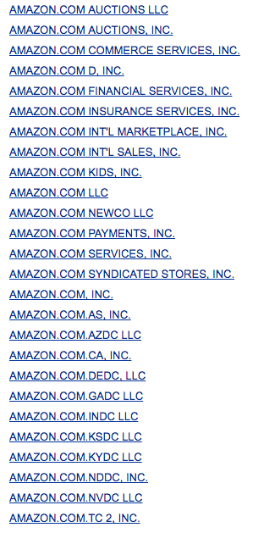

Slide 23
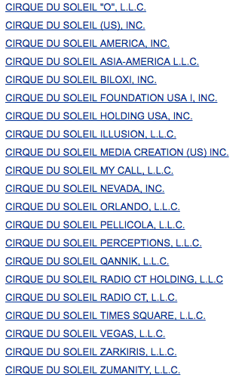
Notes:
SHOWS IN LAS VEGAS

Slide 24
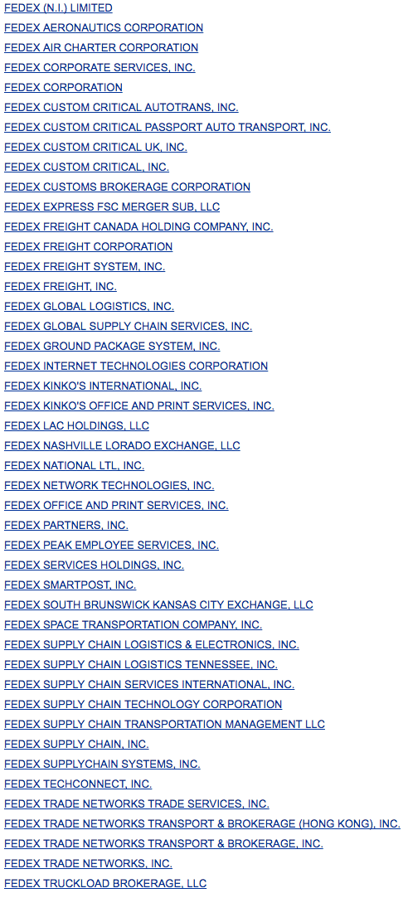
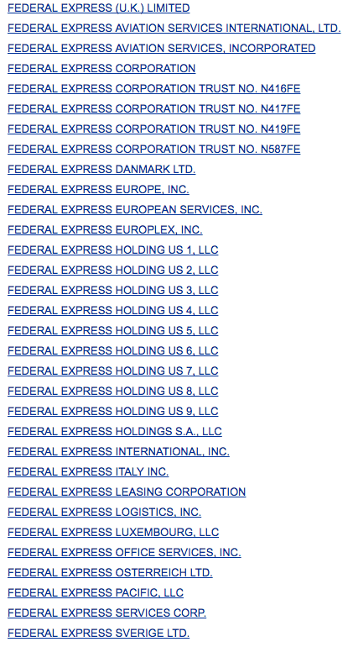
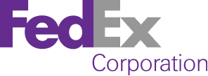

Slide 25
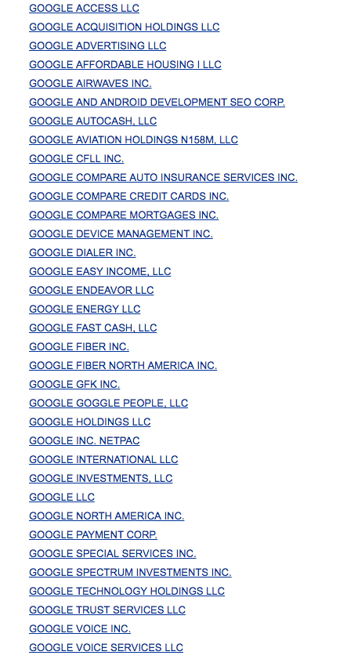

Slide 26
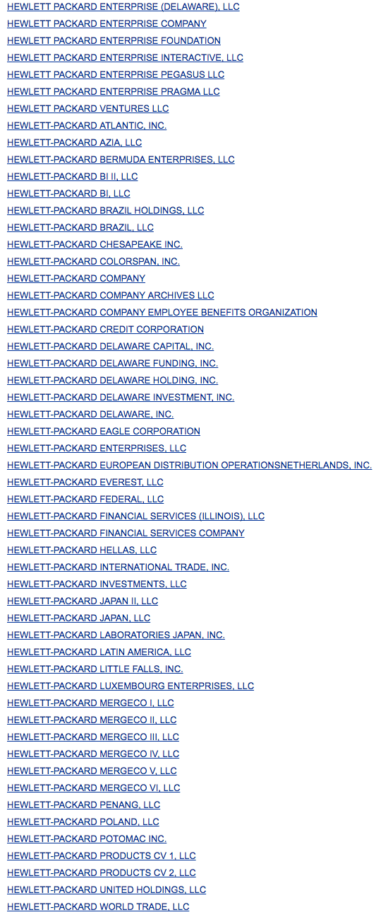

Slide 27
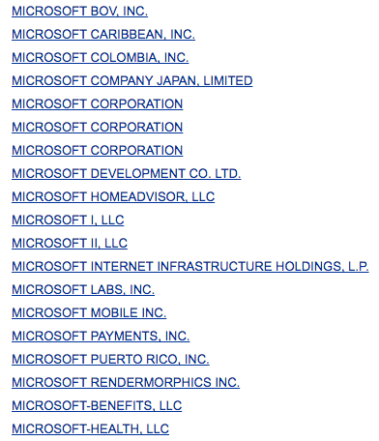

Slide 28
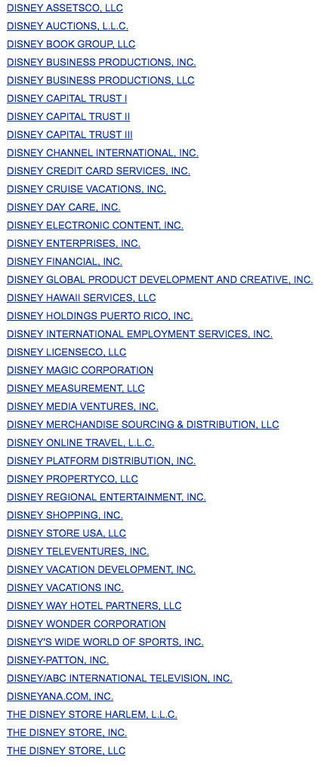
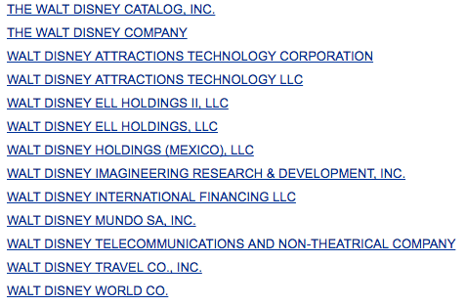

Slide 29
HOLDING
BATEAUX
AVIONS
PROPRIÉTÉ INTELLECTUELLE
FAIRE AFFAIRE DANS ++ ÉTATS
INTERMÉDIAIRE
DROPSHIPPING
FORMATIONS EN LIGNE
SERVICES DÉMATÉRIALISÉS
IMPORT-EXPORT

Slide 30
AUTRES ÉTATS

Slide 31
DANS UN SEUL ÉTAT
Perception POSITIVE
Perception NÉGATIVE

Slide 32
COÛTS DE CRÉATION
COÛTS ANNUELS
COÛTS FISCAUX

Slide 33
JURIDICTIONS POPULAIRES

Slide 34
JURIDICTIONS POPULAIRES

Slide 35
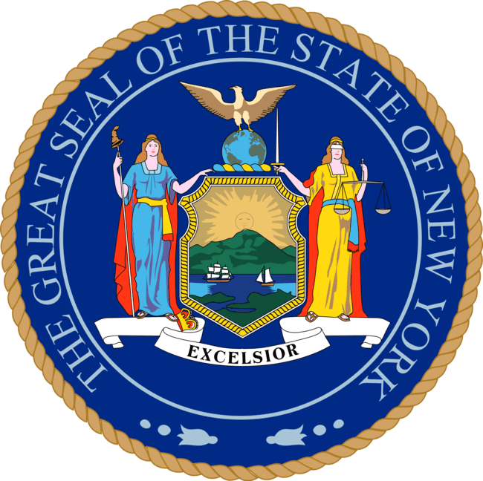
JURIDICTIONS POPULAIRES

Slide 36
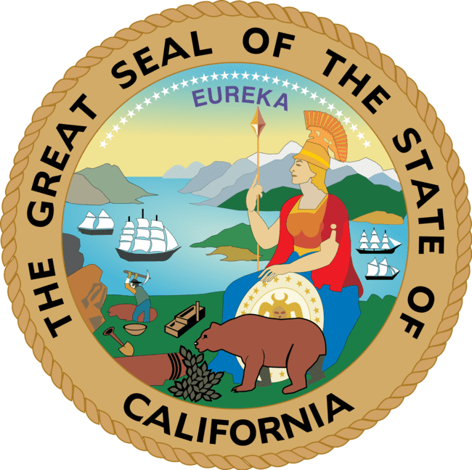
JURIDICTIONS ONÉREUSES

Slide 37
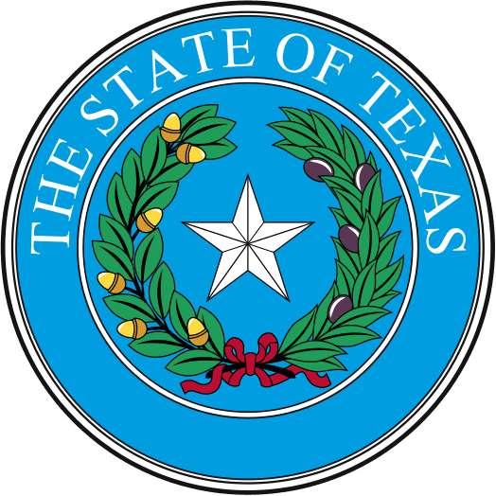
JURIDICTIONS ONÉREUSES

Slide 38
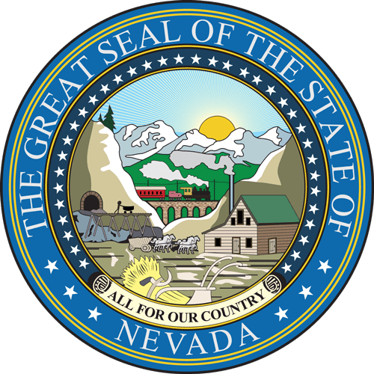
JURIDICTIONS ONÉREUSES

Slide 39
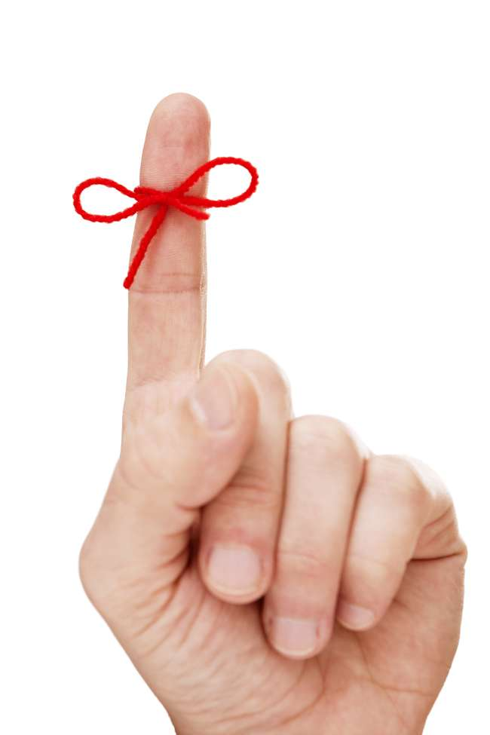
DELAware = NO. 1
CHOIX DE JURIDICTION
SOYONS SÉRIEUX !
Notes:
Each year, a survey is conducted among the 1,000 largest U.S. law firms. This survey includes the best place to start a company in the United States. Invariably for more than 20 years, Delaware has always finished at the top of this survey. In addition, over 95% of CorpoMax customers choose Delaware.
You don't choose a jurisdiction to create a company like you choose a television in a big-box store. If you do not have the knowledge or training to choose the location of your American company, I strongly recommend that you seek the services of a U.S. lawyer, accountant, or tax expert.
Starting an American business is a serious operation. The search for quality information must be just as serious. In other words, be careful what you read in some blogs published by non-professionals.

Slide 40
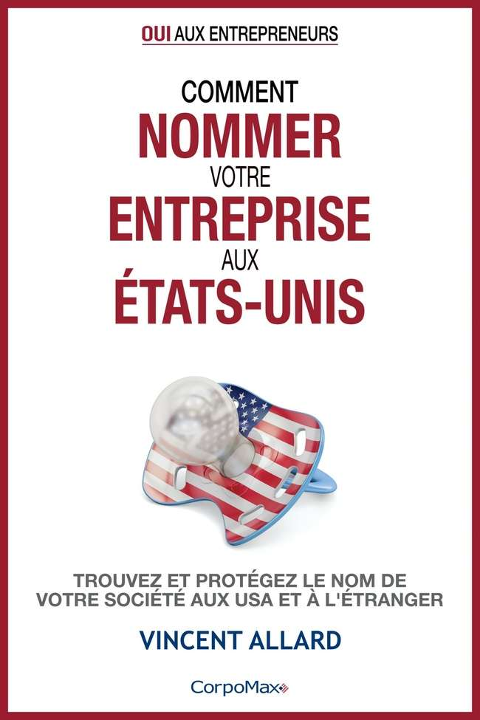
CORPOMAX.COM/GUIDES-PRATIQUES

Slide 41
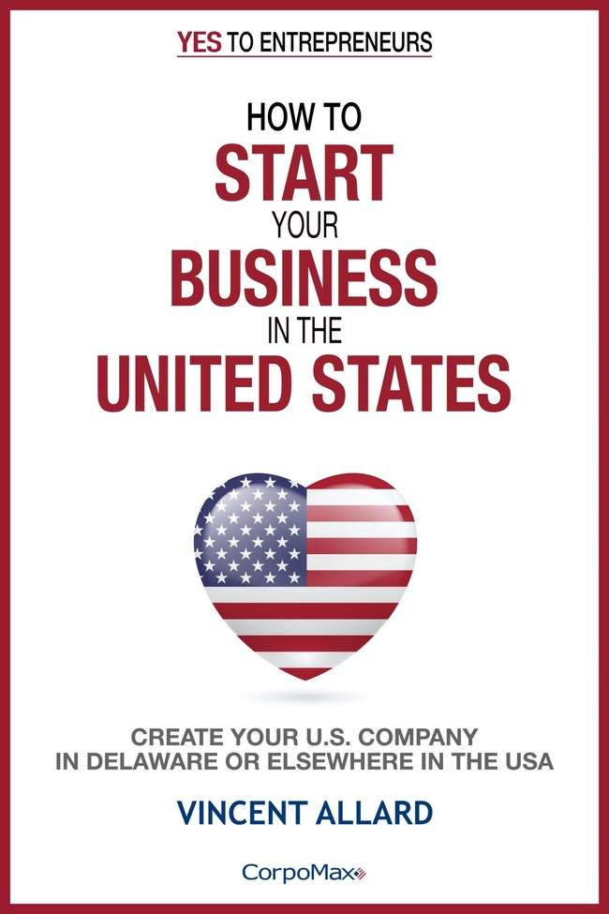
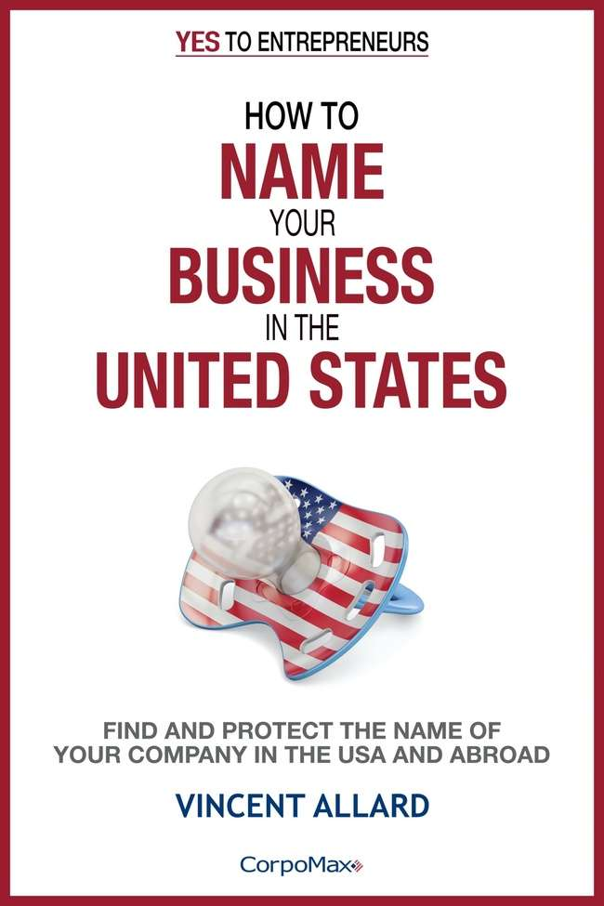
CORPOMAX.COM/PRACTICAL-GUIDES

Slide 42
▪ Création de sociétés américaines ▪ Dépôt de marques américaines
Vincent Allard, avocat (QC)
Président
CorpoMax Inc.
2915 Ogletown Road
Newark, DE 19713, U.S.A.
Tél +1 302 266 8200
Web www.corpomax.com
@ vallard@corpomax.com
Skype corpomax
LinkedIn linkedin.com/in/corpomax
.

